Slide 2
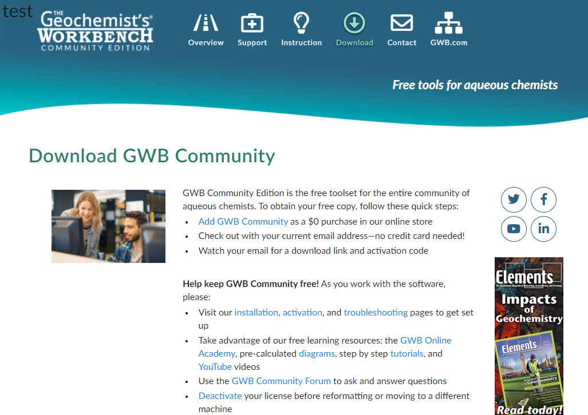
community.gwb.com → Download → Software

Slide 3
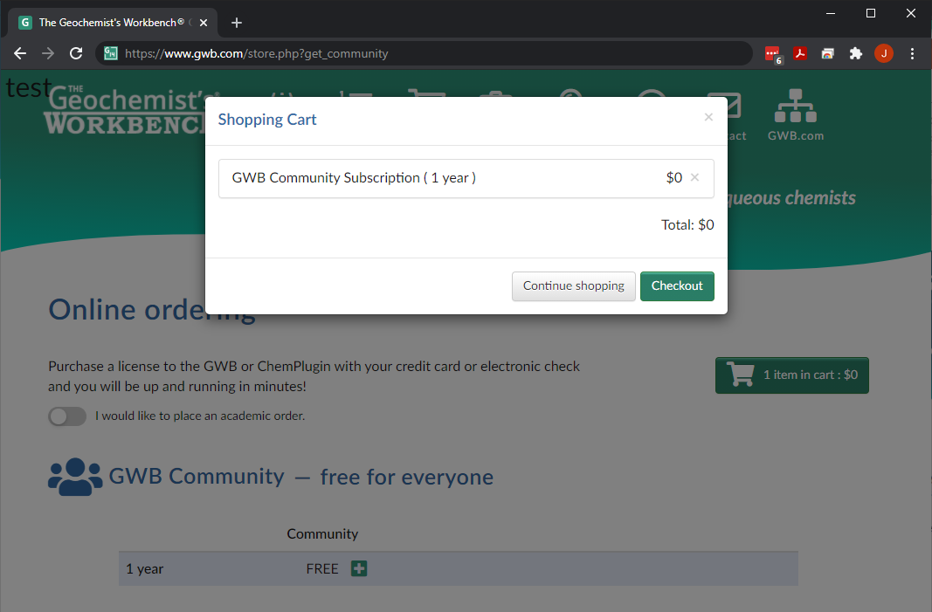
View other GWB products
Finish by checking out

Slide 4
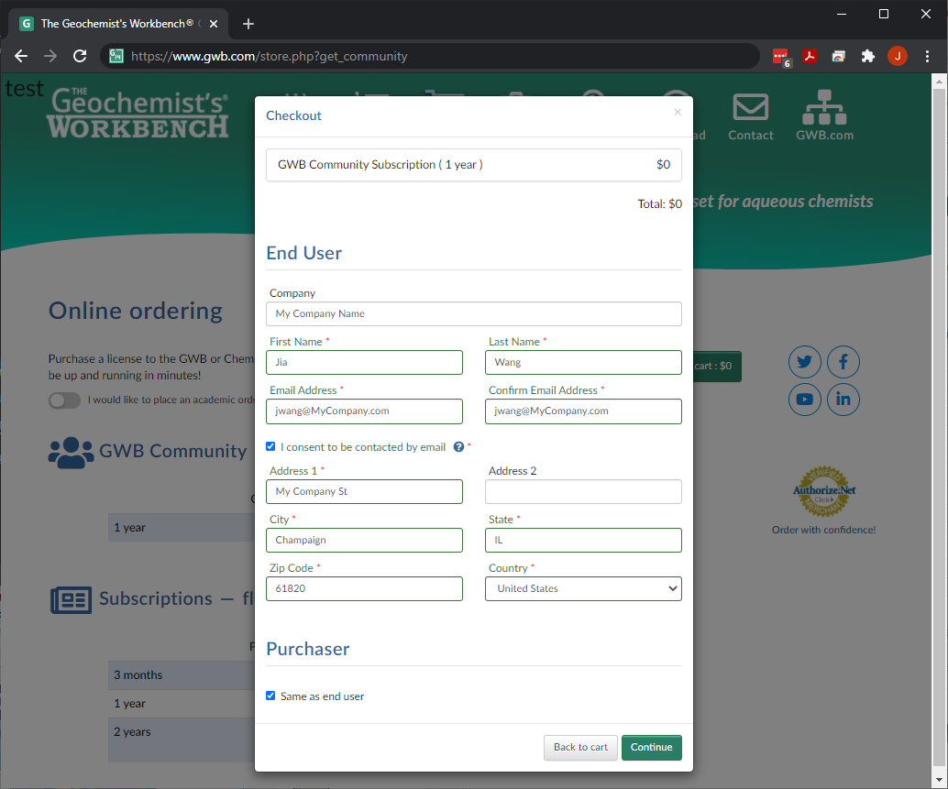
You can complete the End User and Purchaser form.

Slide 5
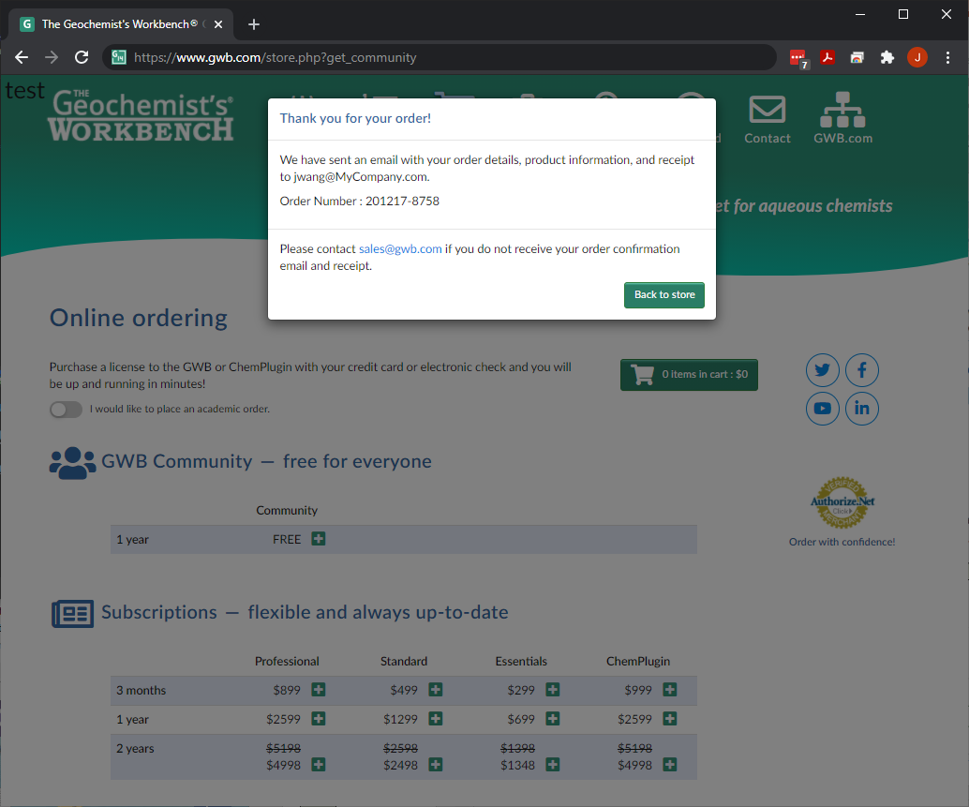
Check your email for receipt and software download information.

