Slide 1
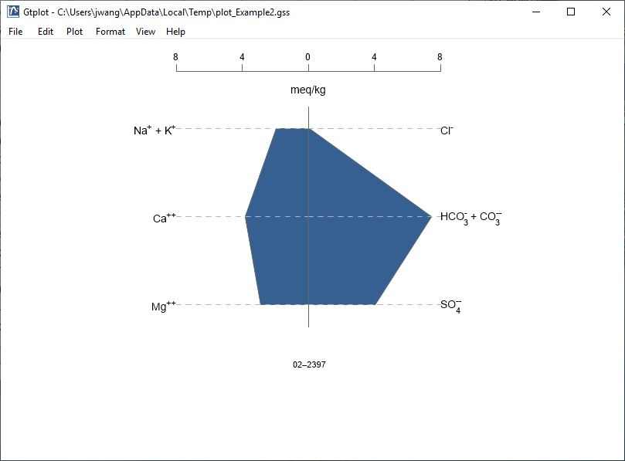
Stiff Diagrams

Slide 2
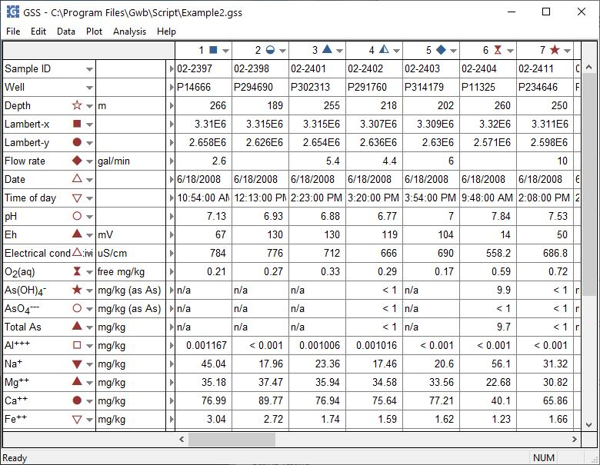
You can launch Gtplot from GSS to create Stiff Diagrams and other specialty plots.
Plot → Stiff Diagram…

Slide 3
Cations and anions plotted on opposite sides in electrical equivalent units.
Right-click on labels or axes to change color, font, size, etc.
Double-click on plot to bring up the Stiff Diagram configuration dialog.
Double-click outside the plot to open the Quick Toggle dialog. Toggle sample labels and more.

Slide 4
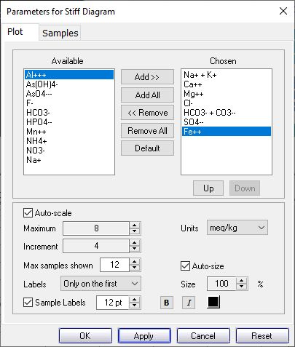
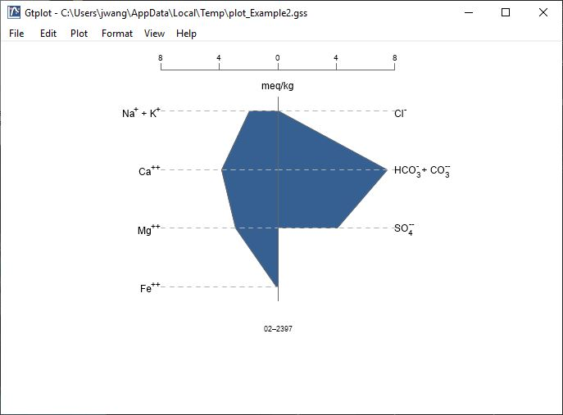
You control details of the Stiff Diagram from the Plot pane.
You can add cations, like Fe⁺⁺, or anions to the default plot. Use Up/ Down to reorder.
Choose max samples to display when cycling through Blocks
When plotting multiple samples, label axes on first plot, all plots, or no plots.

Slide 5
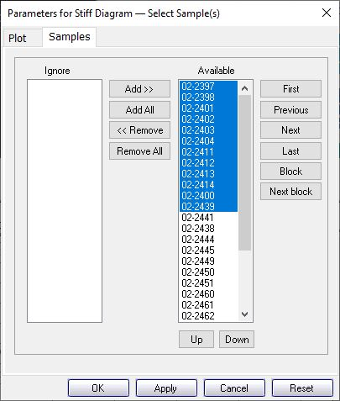
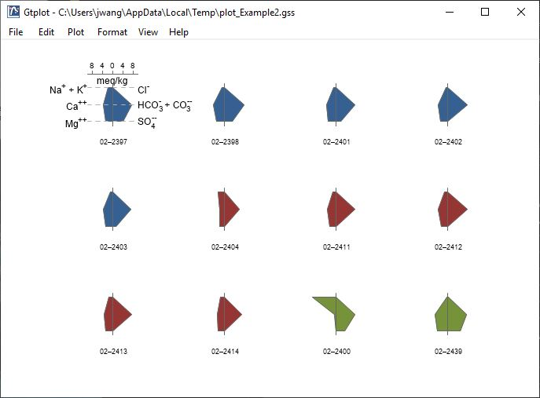
You control which samples are displayed from the Samples pane.
You can also cycle through samples one at a time…
Select the samples to plot.
Use Block, Next block to cycle through groups of samples.

