Slide 1
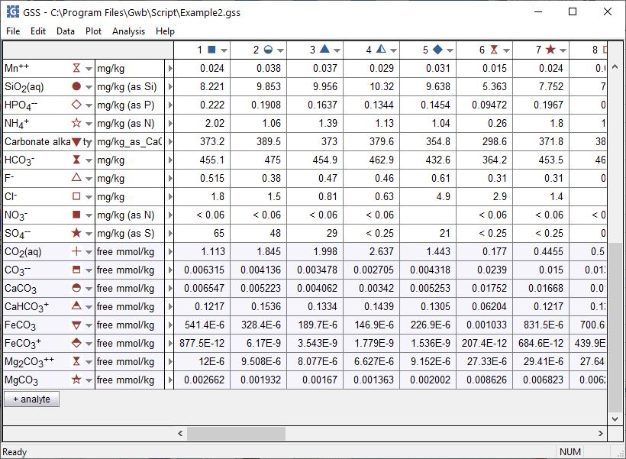
Species distribution and redox state

Slide 2
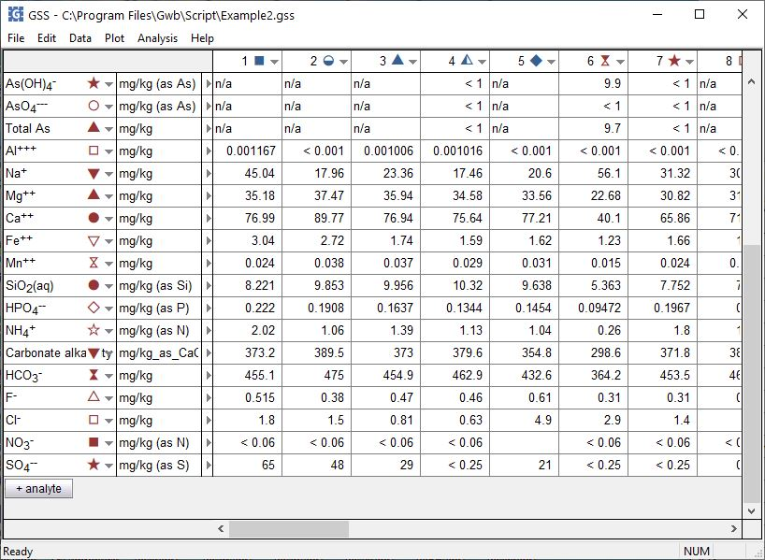
You can calculate the distribution of species and Nernstian Eh for samples in a GSS spreadsheet.
+ analyte → Calculate with SpecE8…

Slide 3
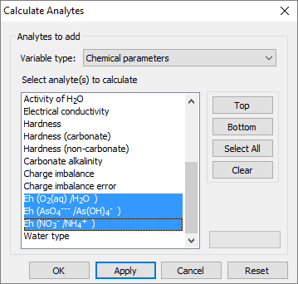
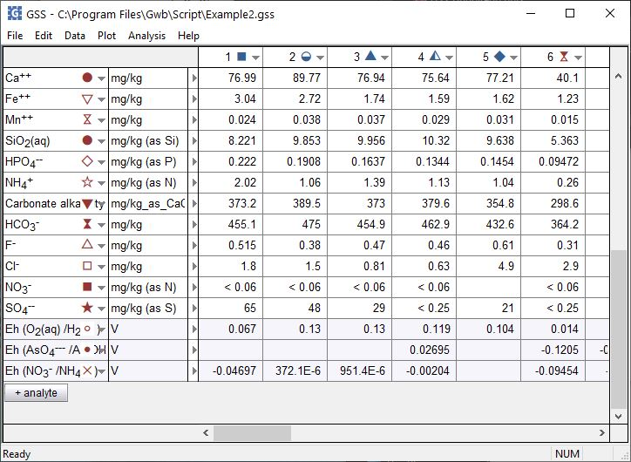
For variable type, choose Chemical parameters
Select one or more parameters, then click Apply
Note, the Treat “less than” values as “no data” option has been unchecked in Data → Options…
Nernstian Eh is calculated where analyses of elements are provided in multiple oxidation states.

Slide 4
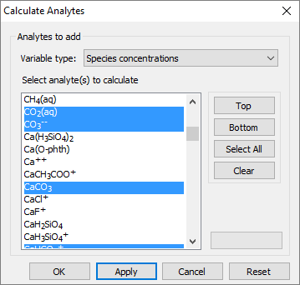
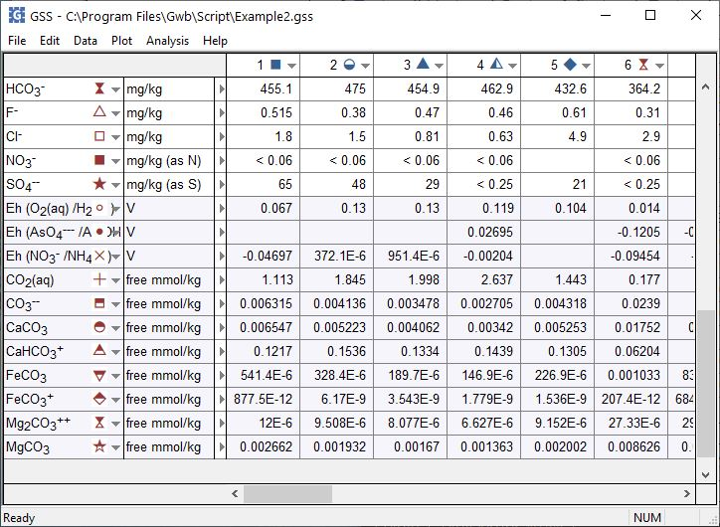
For variable type, choose Species concentrations
You can also calculate species activities or activity coefficients
Select a species, then click Apply
The concentrations of the actual species in solution are reported.

